Slide 1
Applied Cryptography quadratic residue, Euler’s criterion, Legendre symbol
Liangfeng Zhang
School of Information Science and Technology
ShanghaiTech University

Slide 2
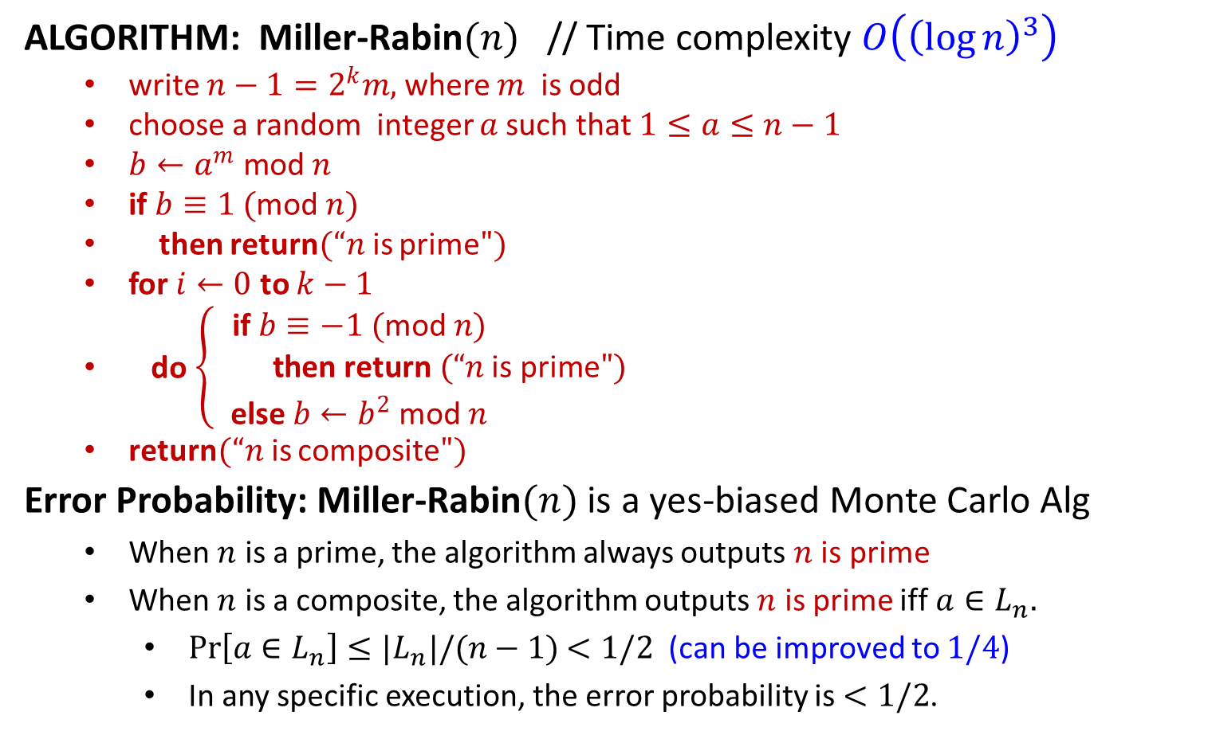
Miller-Rabin Test
ALGORITHM: Miller-Rabin$(n)$ // Time complexity $O\left({\left(\log{n}\right)}^{3}\right)$
write $n−1=2^{k}m,$where $m$ is odd
choose a random integer $a$such that $1≤a≤n−1$
$b←a^{m} \text{mod} n$
if $b≡1$ $($mod $n)$
then return$(“n$is prime$")$
for $i←0$ to $k−1$
do$\left\{\begin{aligned}\text{if} b≡−1 (\text{mod} n) \\ \text{then} \text{return} (“n \text{is} \text{prime}") \\ \text{e}\text{lse} b←b^{2} \text{mod} n \end{aligned}\right.$
return$(“n$is composite$")$
Error Probability: Miller-Rabin$(n)$ is a yes-biased Monte Carlo Alg
When $n$ is a prime, the algorithm always outputs $n$ is prime
When $n$ is a composite, the algorithm outputs $n$ is prime iff $a∈L_{n}.$
$\operatorname{Pr}\left[a∈L_{n}\right]≤|L_{n}|/(n−1)$ $<1/2$ (can be improved to $1/4$)
In any specific execution, the error probability is $<1/2$.

Slide 3

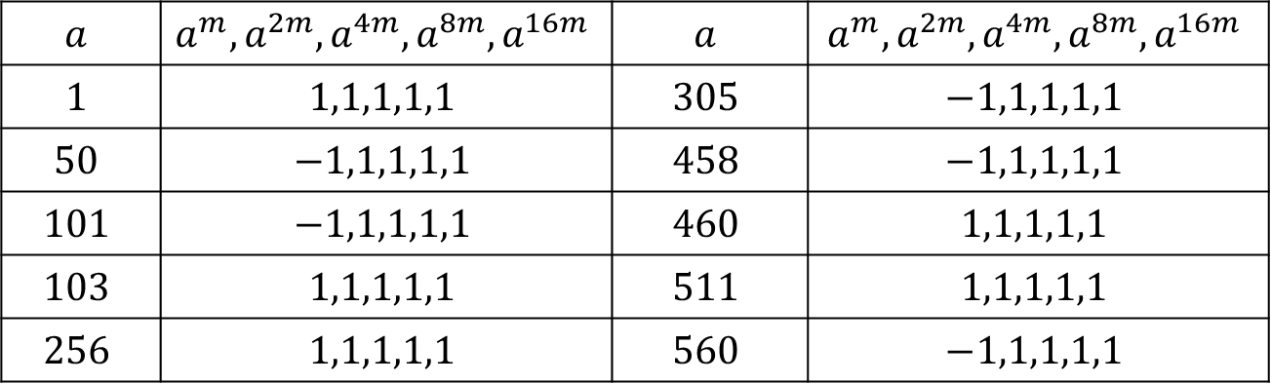
Miller-Rabin Test
EXAMPLE: $n=561. n−1=2^{4}∗35;m=35, k=4$
Miller-Rabin Test: $L_{n}=\{1,50,101,103,256,305,458,460,511,560\}$
error probability $≤\frac{\left|L_{n}\right|}{n−1}$ $=\frac{10}{560}$
Fermat Test: $L_{n}=\left\{a:1≤a≤n−1;a^{n−1}≡1 \left(mod n\right)\right\}=ℤ_{n}^{∗}$
error probability $=\frac{\left|L_{n}\right|}{n−1}$ $=\frac{320}{560}$
Miller-Rabin Test has a much smaller error probability!
$$a$$ | $$a^{m}, a^{2m}, a^{4m}, a^{8m}, a^{16m}$$ | $$a$$ | $$a^{m}, a^{2m}, a^{4m}, a^{8m}, a^{16m}$$
$$1$$ | $$1,1,1,1,1$$ | $$305$$ | $$−1,1,1,1,1$$
$$50$$ | $$−1,1,1,1,1$$ | $$458$$ | $$−1,1,1,1,1$$
$$101$$ | $$−1,1,1,1,1$$ | $$460$$ | $$1,1,1,1,1$$
$$103$$ | $$1,1,1,1,1$$ | $$511$$ | $$1,1,1,1,1$$
$$256$$ | $$1,1,1,1,1$$ | $$560$$ | $$−1,1,1,1,1$$

Slide 5
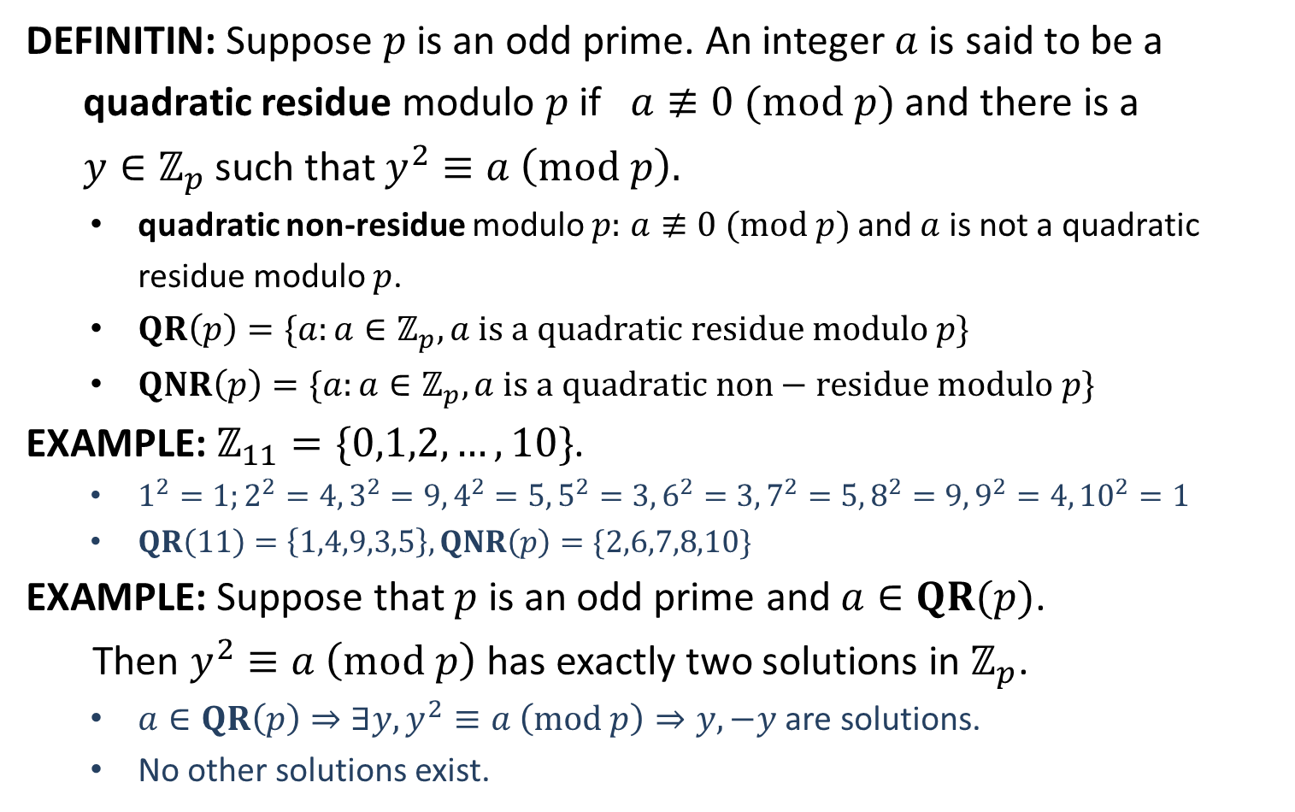
Quadratic Residue
DEFINITIN: Suppose $p$ is an odd prime. An integer $a$ is said to be a
quadratic residue modulo $p$ if $a≢0 (mod p)$ and there is a
$y∈ℤ_{p}$ such that $y^{2}≡a \left(mod p\right).$
quadratic non-residue modulo $p:$ $a≢0 (mod p)$ and $a$ is not a quadratic residue modulo $p$.
$QR\left(p\right)=\{a:a∈ℤ_{p}^{ }, a is a quadratic residue modulo p\}$
$QNR\left(p\right)=\{a:a∈ℤ_{p}^{ }, a is a quadratic non−residue modulo p\}$
EXAMPLE: $ℤ_{11}=\{0,1,2,…,10\}$.
$1^{2}=1;2^{2}=4, 3^{2}=9, 4^{2}=5, 5^{2}=3, 6^{2}=3, 7^{2}=5, 8^{2}=9, 9^{2}=4, {10}^{2}=1$
$QR\left(11\right)=\left\{1,4,9,3,5\right\},QNR\left(p\right)=\{2,6,7,8,10\}$
EXAMPLE: Suppose that $p$ is an odd prime and $a∈QR(p)$.
Then $y^{2}≡a \left(mod p\right)$ has exactly two solutions in $ℤ_{p}$.
$a∈QR\left(p\right)⇒∃y, y^{2}≡a \left(mod p\right)⇒y,−y$ are solutions.
No other solutions exist.

Slide 6

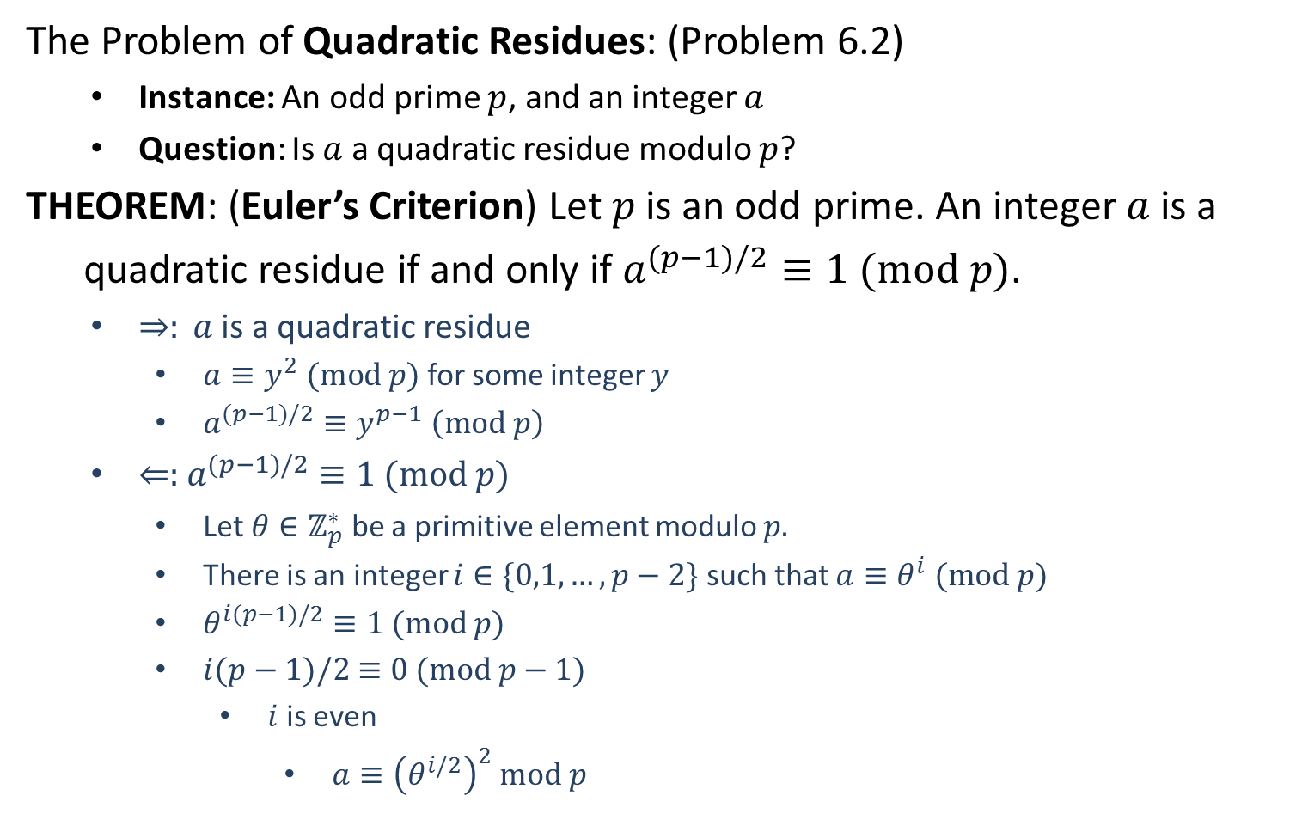
Decide Quadratic Residues
The Problem of Quadratic Residues: (Problem 6.2)
Instance: An odd prime $p$, and an integer $a$
Question: Is $a$ a quadratic residue modulo $p$?
THEOREM: (Euler’s Criterion) Let $p$ is an odd prime. An integer $a$ is a
quadratic residue if and only if $a^{(p−1)/2}≡1 (mod p)$.
$⇒: a$ is a quadratic residue
$a≡y^{2} (mod p)$ for some integer $y$
$a^{(p−1)/2}≡y^{p−1} \left(mod p\right)$
$⇐:$ $a^{(p−1)/2}≡1 (mod p)$
Let $θ∈ℤ_{p}^{∗}$ be a primitive element modulo $p.$
There is an integer $i∈\{0,1,…,p−2\}$ such that $a≡θ^{i} (mod p)$
$θ^{i(p−1)/2}≡1 (mod p)$
$i(p−1)/2$ $≡0 (mod p−1)$
$i$ is even
$a≡{\left(θ^{i/2}\right)}^{2}$ $mod p$
$$≡1 (mod p)$$

Slide 7

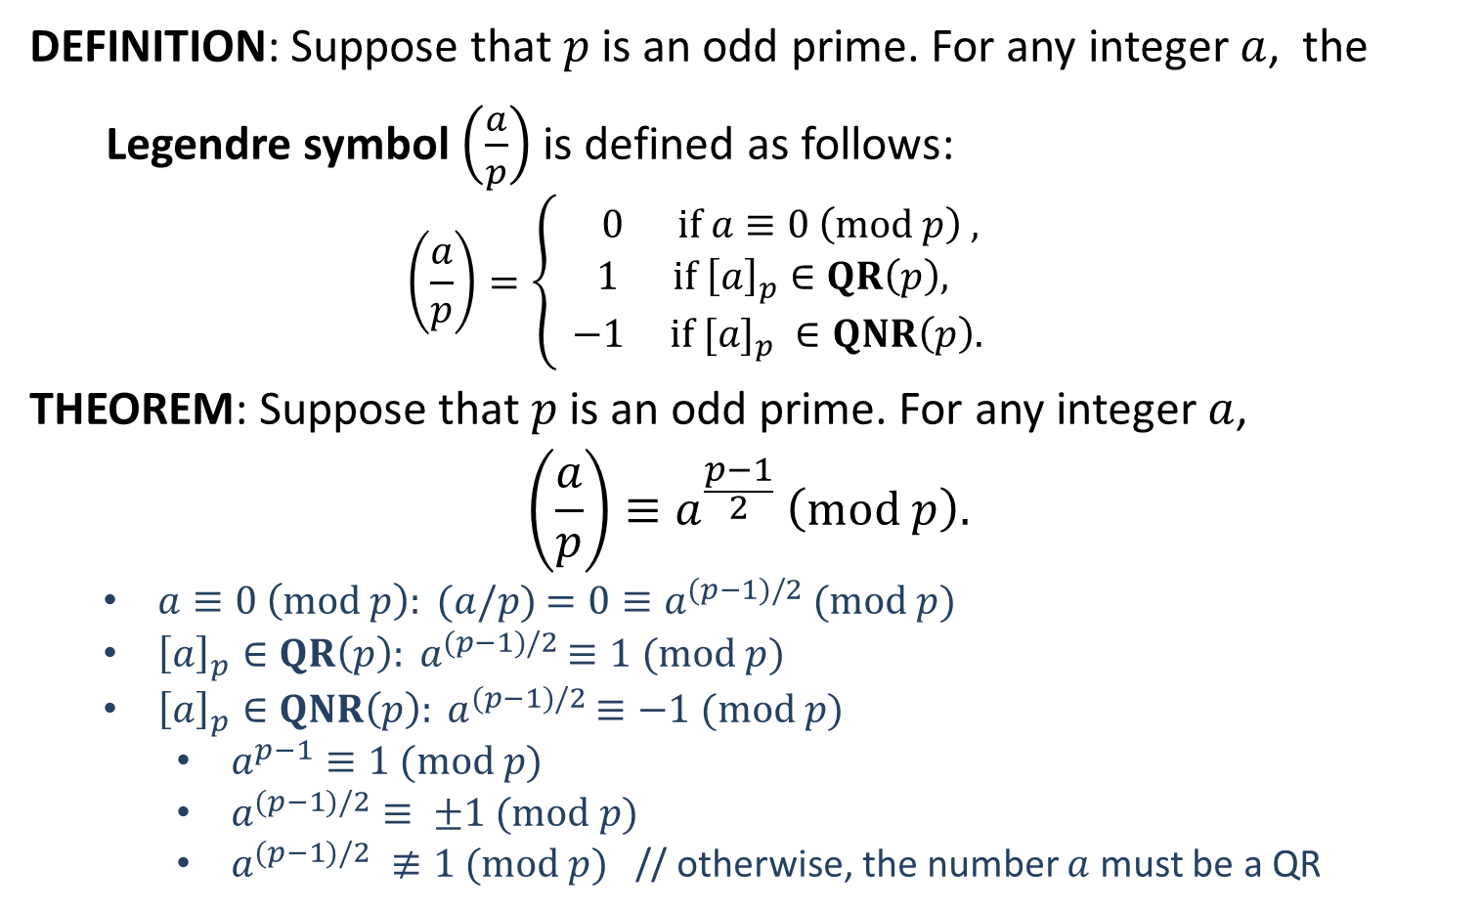
Legendre Symbol
DEFINITION: Suppose that $p$ is an odd prime. For any integer $a$, the
Legendre symbol $\left(\frac{a}{p}\right)$ is defined as follows:
$$\left(\frac{a}{p}\right)=\left\{\begin{aligned} 0 if a≡0 \left(mod p\right) , \\ 1 if {\left[a\right]}_{p}∈QR\left(p\right), \\ −1 if [a]_{p} ∈QNR\left(p\right). \end{aligned}\right.$$
THEOREM: Suppose that $p$ is an odd prime. For any integer $a$,
$$\left(\frac{a}{p}\right)≡a^{\frac{p−1}{2}} \left(mod p\right).$$
$a≡0 \left(mod p\right): (a/p)$ $=0≡a^{(p−1)/2}$ $(mod p)$
${\left[a\right]}_{p}∈QR\left(p\right): a^{(p−1)/2}$ $≡1$ $(mod p)$
${\left[a\right]}_{p}∈QNR\left(p\right): a^{(p−1)/2}$ $≡−1$ $(mod p)$
$a^{p−1}≡1 (mod p)$
$a^{(p−1)/2}≡ ±1 (mod p)$
$a^{(p−1)/2} ≢1 (mod p)$ // otherwise, the number $a$ must be a QR
$$\left(\frac{−1}{p}\right)={\left(−1\right)}^{\frac{p−1}{2}}$$

